Slide 1


Evaluating Explainable AI Methods
In Domains of Varying Human Impact
Students: Adan Ibrahim, Yarden Nahum
Supervisors: Dr. Julia Sheidin, Dr. Avital Shulner Tal
GITHUB
Capstone Project Phase A | 26-1-R-3
Notes:
Hi everyone, my name is Yarden, and this is Adan. Our project is about evaluating Explainable AI methods in domains with different levels of human impact.

Slide 2




Project Motivation
AI supports decisions across domains with varying human impact.
Many AI systems lack transparency and clear reasoning.
Trust requirements differ between different risk levels.
The suitability of XAI methods varies across domains.
Notes:
Moving on to the motivation for the project. Today, AI is used to make decisions in many different fields, from movie recommendations to healthcare. The problem is that many AI systems are not transparent. Users often don't know why the AI made its decision. this creates a trust issue among users. However, not all decisions have the same risk. Therefore, we believe that decision with different risk levels require different levels of trust and different types of explanations. So, our goal is to find out which explanation method works best for each domain

Slide 3
Background and Related work
Notes:
Now, let's move on to the Background and Related Work. In this section, we will discuss the evolution of AI, the 'Black Box' problem, how risk levels affect user trust and Explainable ai methods

Slide 4



AI Evolution & Adoption Across Domains
AI has evolved significantly over the years, transitioning from rule-based systems to a central component in decision-making processes across multiple domains.
For Example:
In Healthcare, systems now analyze medical images to support diagnosis .
In Finance, algorithms drive credit scoring and investment strategies.
In Logistics, AI models are essential for route planning and inventory management.
Notes:
AI has evolved significantly over the years. It transitioned from simple rule-based systems to becoming a central part of decision-making.
We can see this in many domains: In Healthcare, AI analyzes medical images to support diagnosis. In Finance, algorithms decide on credit scoring and investments. And in Logistics, AI is essential for route planning and inventory management.

Slide 5
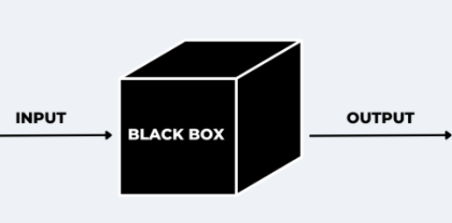
The Black Box Problem
The main challenge with modern AI is the Black Box problem.
While the input and output of AI systems are observable, the internal decision-making logic remains hidden.
As a result, users are unable to understand how decisions are made, which directly affects their trust in the system.
Notes:
However, this growing use of AI brings a major challenge: The Black Box Problem.
While we can see the input and the output, the internal decision-making logic remains hidden inside a 'black box'.
As a result, users cannot understand how decisions are reached, and this directly affects their trust in the system.

Slide 6



The Impact of Risk on AI Decision-Making
AI's impact on decision-making varies across domains with different risk levels, each presenting unique challenges and opportunities.
In this research, we define these risk levels as follows:
High Risk
Medium Risk
Low Risk
Decisions with significant, potentially life-altering consequences.
Decisions that influence individuals’ livelihoods but do not pose direct danger.
Decisions with limited direct impact on personal well-being
Notes:
AI's impact on decision-making varies across domains with different risk levels, and each one presents unique challenges.
In this research, we define these risk levels as follows:
High Risk: Decisions with life-altering consequences. Medium Risk: Decisions that influence livelihood but are not dangerous. Low Risk: Decisions with limited impact on personal well-being.

Slide 7

The Impact of Risk on AI Decision-Making
Each domain is characterized by distinct decision-making contexts, where errors may lead to different consequences.
Notes:
This leads us to a key point: Context matters. An error in one field is not the same as an error in another field. The consequences can be very different. Therefore, different risk levels require different levels of trust.

Slide 8
User Trust
Trust is a central value in AI decision-making, but its nature changes depending on the context.
High-Risk Decisions
Low-Risk Decisions
Users require Cognitive Trust, based on understanding and evidence.
High accuracy alone is not enough, users must understand the reasoning behind a decision to truly trust it.
Users often rely on Emotional Trust, based on intuition or a general feeling.
Notes:
8-14 adan

Slide 9

User Trust
This highlights the need for transparency and explainability in AI-supported decision-making.

Slide 10

Explainable Artificial Intelligence (XAI)
XAI makes AI decisions transparent and understandable.
It addresses the black-box problem by explaining how predictions are made.
XAI supports user trust and responsible decision-making.
LIME
SHAP
DICE
Simplifies the complex model to explain "why" a specific decision was made.
Shows how much each factor contributes to the final decision.
Shows minimal changes needed to alter a decision.

Slide 11

Literature Review Summary
To summarize our literature review, we reach three key conclusions:
1
2
3
Context Is Key
AI is integrated across diverse domains, where the risk level directly dictate the required type and depth of explanation.
The Trust Gap
The Black Box problem prevents users from trusting the system, especially when the stakes are high.
XAI Is The Bridge
Explainable AI is the solution to this gap.
By using it we can transform a 'Black Box' into a transparent tool.
This leads directly to our research goal: To test which of the XAI explanation methods is most effective for each specific risk level.

Slide 12
Research Process

Slide 13



Our Goal
Developing a system that evaluates Explainable AI methods across domains with different human impact.
Comparing how users perceive and trust different XAI tools in high, medium, and low risk decision contexts.
Provide insights into how explanation preferences change based on domain risk.

Slide 14



Chosen Datasets
HEALTHCARE
HUMAN RESOURCES
TEXT ANALYSIS
Diabetes Health Indicators
IBM HR Analytics Attrition
LLM - AI Generated Text
100,000 patient profiles
35+ features
1,470 employee records
35 features
28,000 essays including human-written and AI text analysis
A dataset for predicting diabetes, representing high-stakes medical diagnosis.
Focuses on predicting employee turnover, representing significant professional impact.
Distinguishes between human and machine-written text, representing a lower risk.

Slide 15
Research Flow
1
2
3
4
The system presents Domain Record & AI Prediction
User reviews SHAP, LIME, and DICE visuals
User rates Trust & Clarity (SCS & FATE)
Save feedback and move to the next domain
Notes:
The Research Flow consists of four main steps:
1. First, the system presents the explanations for a specific domain and the AI's prediction.
2. Second, the user reviews the explanations generated by SHAP, LIME, and DICE.
3. Third, the user rates the Trust and Clarity of the explanations using our questionnaires.
4. Finally, the system saves the feedback, and the user moves on to the next domain.

Slide 16

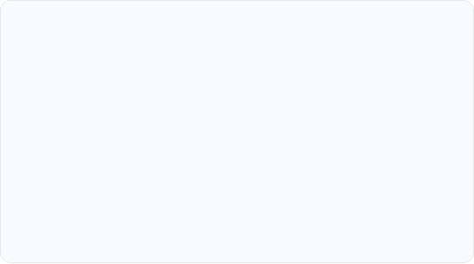
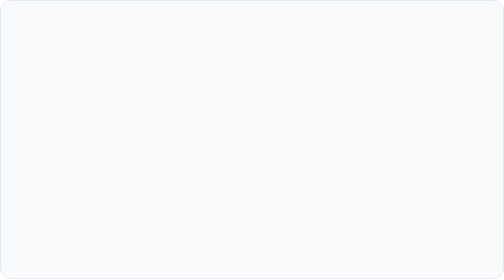
Research Logic
Offline Phase
Online Phase
The system processes data and trains the models. For each selected record, explanations are pre-generated using all three algorithms (SHAP, LIME, DiCE) and stored in the database for retrieval.
In real-time (during the experiment), the interface retrieves a prepared scenario from the DB. The user views the data, the model's decision, and the explanations, then fills out an evaluation questionnaire.
Notes:
The research logic is divided into two phases:
First, the Offline Phase: This happens beforehand. We train the models and pre-generate all the explanations – SHAP, LIME, and DiCE – and store them in our database.
Second, the Online Phase: This happens in real-time during the experiment. The system retrieves a prepared scenario, shows it to the user, and then the user fills out the evaluation questionnaire.

Slide 17
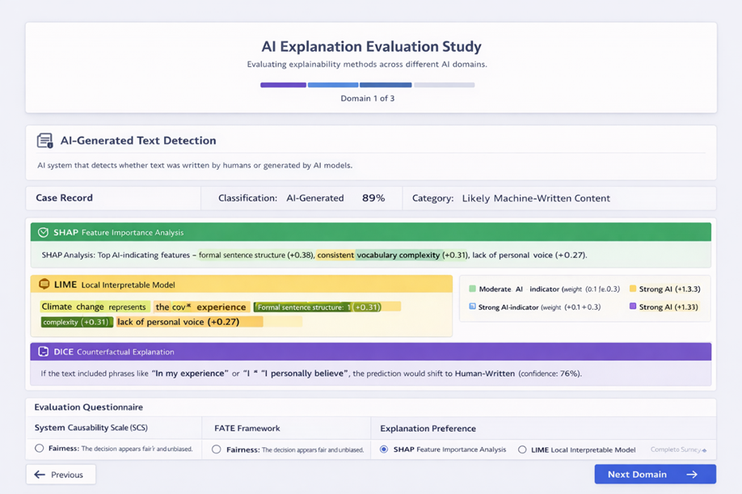
User Interface (GUI)
Notes:
Let's look at our GUI.
At the top, you can see the AI's prediction. Below it, we present the three explanations – SHAP, LIME, and DiCE – side-by-side.
This allows the user to easily compare the insights. Finally, at the bottom, there is a section for user feedback and evaluation.

Slide 18


Challenges
Phase A Challenges:
Selecting datasets that accurately reflect different risk levels.
Maintaining a clear and well-structured report.
Phase B Challenges:
Recruiting a sufficient number of participants to ensure meaningful results.
Ensuring the models generate meaningful explanations.
Notes:
During Phase A of the project, we faced two main challenges: First, we had to carefully select datasets that accurately reflected the different risk levels we defined. Second, we put a lot of effort into maintaining a clear and well-structured report.
Looking ahead to Phase B, we anticipate two new challenges:
Recruiting enough participants for the user study.
And Ensuring the the models generate meaningful and clear explanations.

Slide 19
Evaluation Plan
Notes:
Now, let's move on to our Evaluation Plan. In this section, we will explain how we measure user trust and the quality of the explanations.

Slide 20
User Evaluation
1
(Strongly Disagree)
2
3
4
5
(Strongly Agree)
System Causability Scale(SCS) :
Causal Factors: I found that the data included all relevant known causal factors with sufficient precision.
Causality: I found the explanations helped me to understand the cause-and-effect relationship in the prediction.
Context: I understood the explanations within the context of the domain.
Support: I did not need support or external help to understand the explanations.
Learnability: I think that most people would learn to understand these explanations very quickly.
Efficiency: I received and understood the explanations in a timely and efficient manner.
https://link.springer.com/article/10.1007/s13218-020-00636-z
Notes:
The first tool we used is the System Causability Scale, or SCS.
This scale measures if the explanation actually helps the user understand the cause of the AI's decision. We will ask participants to rate statements on a scale from 1 to 5, we chose to focus on six factors.
for example:
Causal Factors: to check if the data was detailed enough.
Context: to ensure the explanation made sense within the specific domain.
The other factors are casualty support learnability and efficency
1. Causal Factors: We wanted to check if the users felt the data was detailed enough.
2. Causality: did the explanation actually show the cause-and-effect?
3. Context: We needed to know if the explanation makes sense within the specific domain, like healthcare or HR.
4. Support: checked if users could understand the explanations without external help.
5. Learnability: We asked if new users could understand the explanations quickly.
6. Efficiency: Finally, we wanted to ensure the explanation was understood in a timely manner.

Slide 21
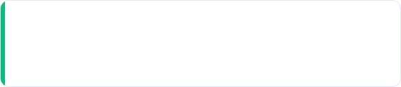
User Evaluation
FATE: To measure user trust, we evaluate explanations based on four key perception metrics:
Causability
C
1. I understood the explanations within the context of my work.
2. I did not need support to understand the explanations.
3. I found the explanations helped me to understand causality.
https://www.sciencedirect.com/science/article/pii/S1071581920301531
Notes:
21-25 adan

Slide 22
User Evaluation
FATE: To measure user trust, we evaluate explanations based on four key perception metrics:
Trust
T
1. I trust the recommendations by algorithms-driven services.
2. Recommended items through algorithmic processes are trustworthy.
3. I believe that the algorithm service results are reliable.
https://www.sciencedirect.com/science/article/pii/S1071581920301531

Slide 23
User Evaluation
FATE: To measure user trust, we evaluate explanations based on four key perception metrics:
Satisfaction
S
1. Largely, I am fairly pleased with algorithm services.
2. Overall, the algorithm services fulfill my initial expectations.
3. Generally, I am happy with the contents of algorithm services.
https://www.sciencedirect.com/science/article/pii/S1071581920301531

Slide 24
User Evaluation
FATE: To measure user trust, we evaluate explanations based on four key perception metrics:
Transparency
T
1. I think that the evaluation and the criteria of algorithms used should be publicly released and understandable to people (Understandability).
2. Any outputs produced by an algorithmic system should be explainable to the people affected by those outputs (Explainability)
3. Algorithms should let people know how well internal states of algorithms can be understood from knowledge of its external outputs (Observability)
https://www.sciencedirect.com/science/article/pii/S1071581920301531

Slide 25
Testing Plan
Verifying that the system correctly generates SHAP, LIME, and DiCE explanations and saves them to the database.
Ensuring the system correctly displays the predictions and explanations for each domain and that every user sees the exact same instances.
Checking that the users can review the explanations and that their feedback through the SCS and FATE questionnaires is saved in the database.

Slide 26
Evaluation Plan
Participants: Real users will review AI decisions.
Explanations: Comparing effectiveness of SHAP, LIME, and DiCE through Fate and SCS frameworks.
Data Collection: All user responses and feedback are systematically saved for analysis.

Slide 27


Next Steps For Phase B
Training the models and Pre-generating SHAP, LIME, and DiCE explanations.
Same predefined decision instance for all users
Review across Healthcare, HR, and Text domains
User feedback via SCS & FATE questionnaires
Results analyzed across risk levels
Notes:
So, what are the next steps for Phase B?
First, we will train the models and pre-generate the SHAP, LIME, and DiCE explanations. We do this to ensure that every user sees the exact same decision instance, allowing for a fair comparison.
Once the system is ready, users will review these explanations across all three domains: Healthcare, HR, and Text Analysis.
We will then collect their feedback using the SCS and FATE questionnaires. And finally, we will analyze the results to understand how different risk levels impact the user’s preference.

Slide 28
Thank you !
Any Questions?
Notes:
To summarize our project:
We started with the challenge of the 'Black Box' and the lack of user trust. Our key insight is that context matters – a high-risk decision needs a different explanation than a low-risk one.
To test this, we will build a system that compares SHAP, LIME, and DiCE across three different domains.
Ultimately, our goal is to find the best explanation method for each level of risk.

